Slide 1
Layers of the Atmosphere and where clouds can form

Slide 2
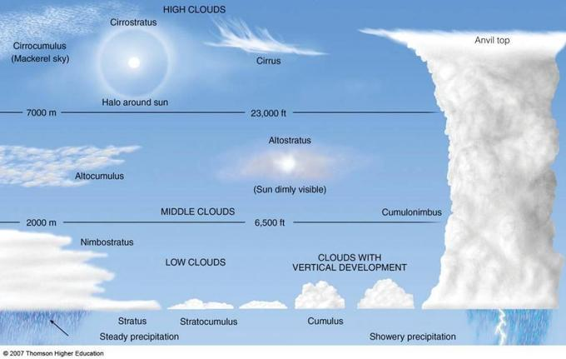

Slide 3
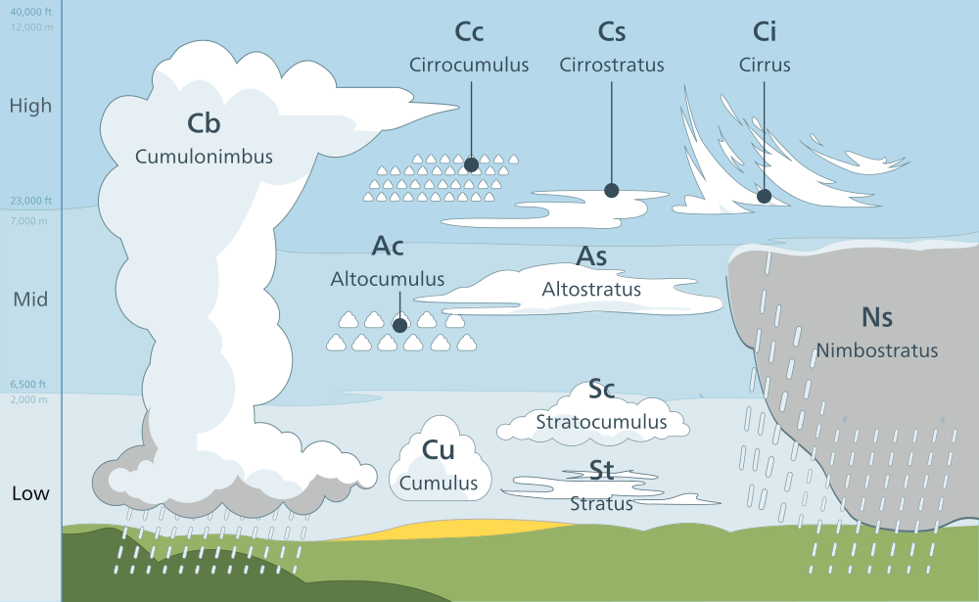

Slide 4
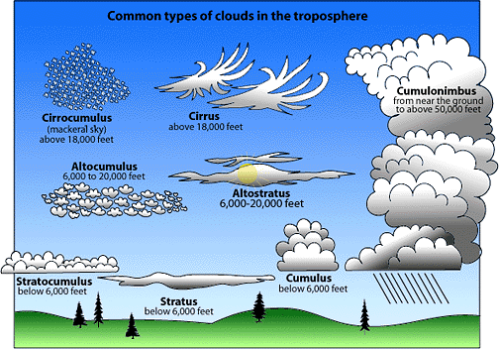

Slide 5
Cloud Types with Example Images

Slide 6
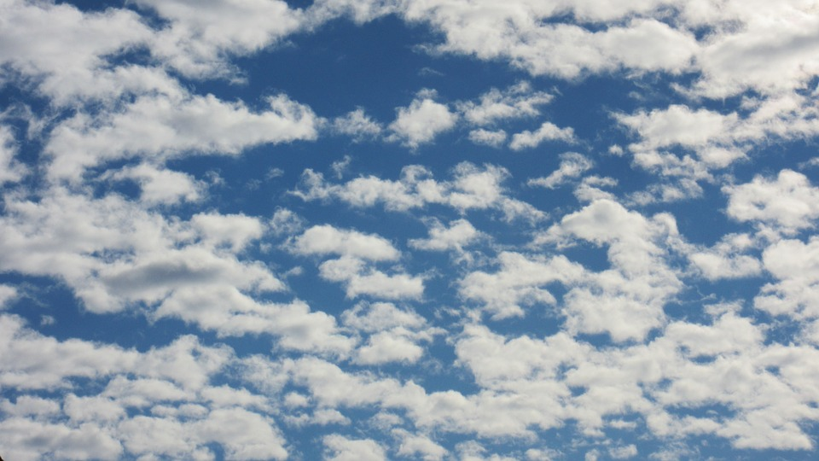
Altocumulus clouds

Slide 7
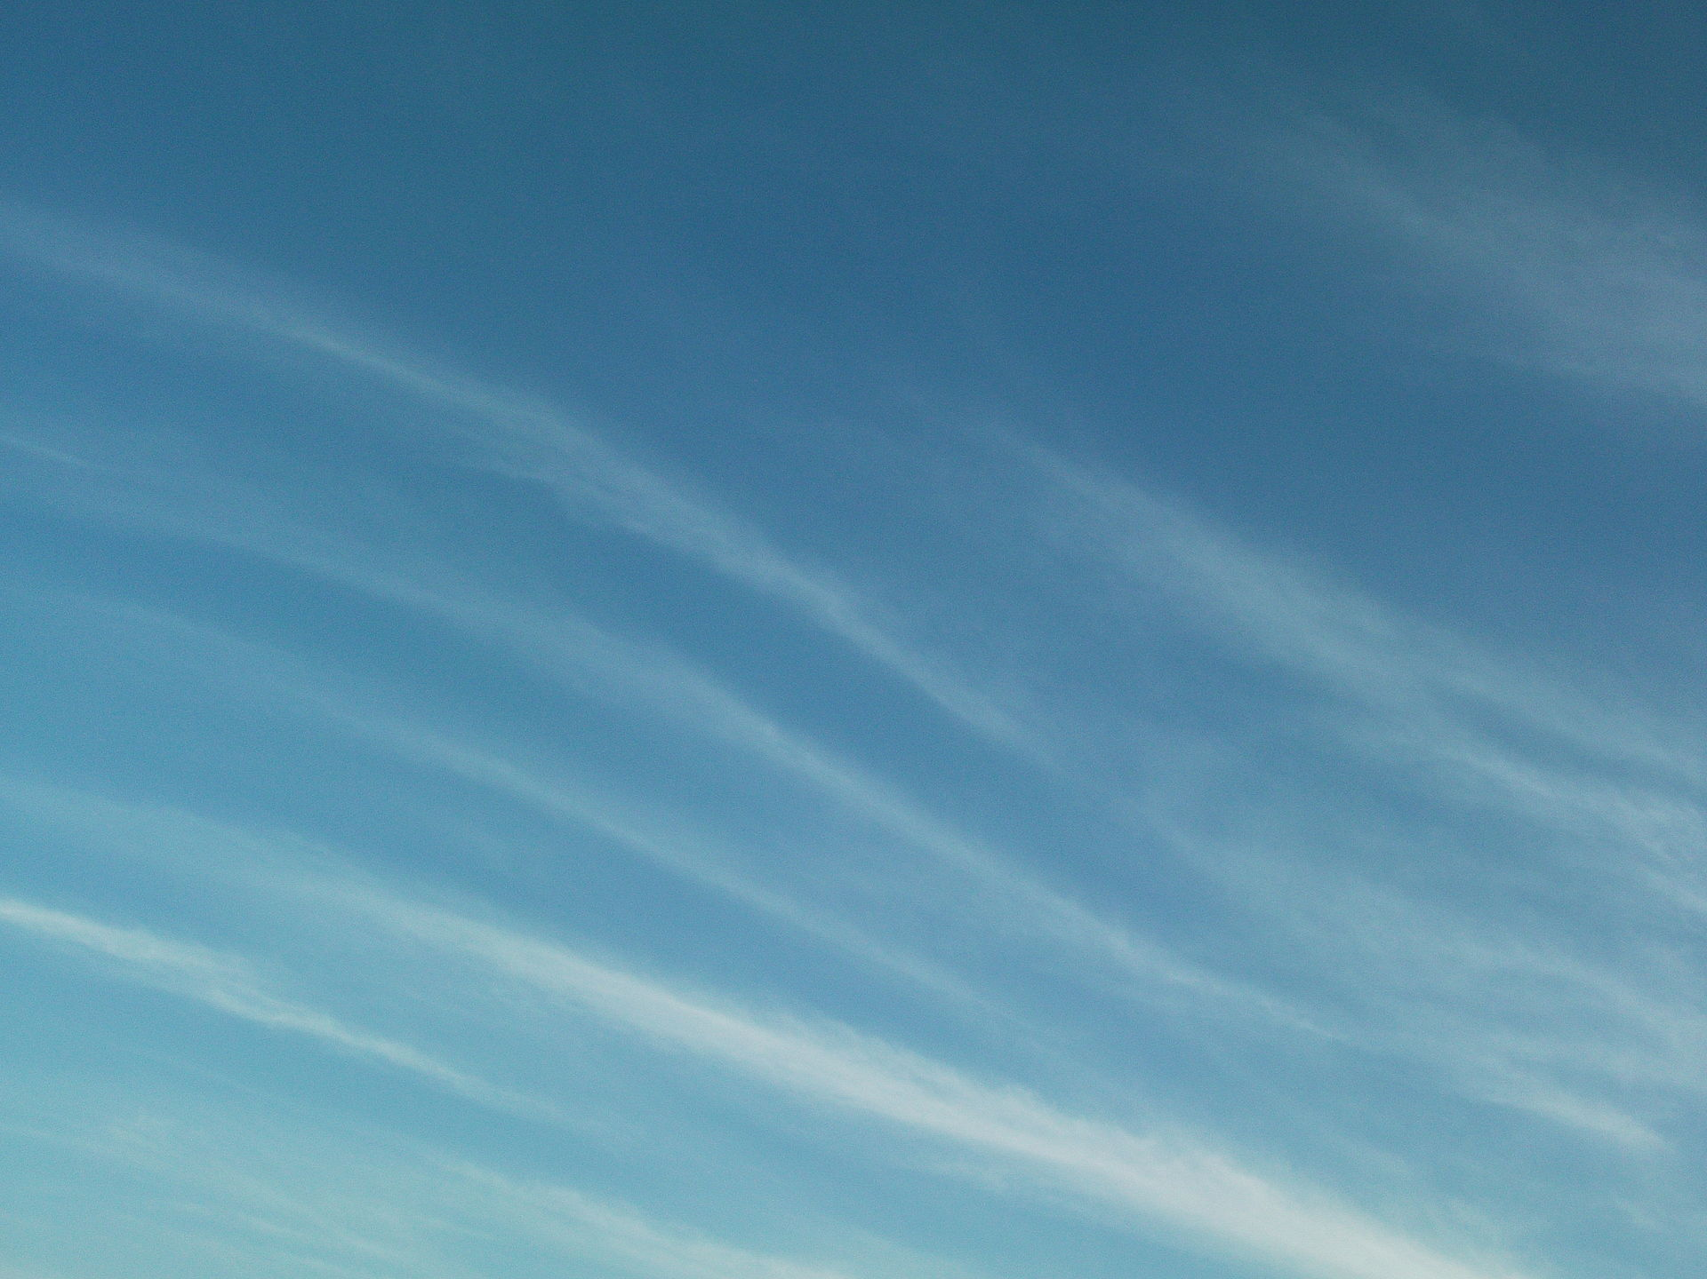
Cirrus clouds

Slide 8
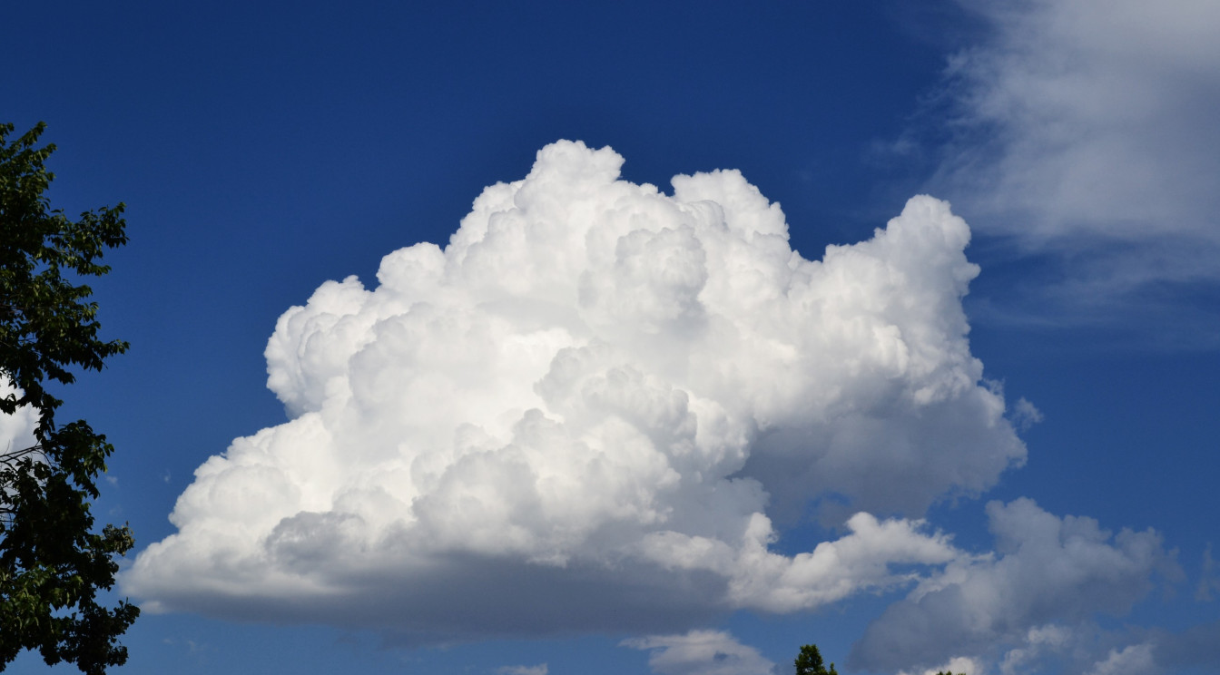
Cumulus clouds

Slide 9
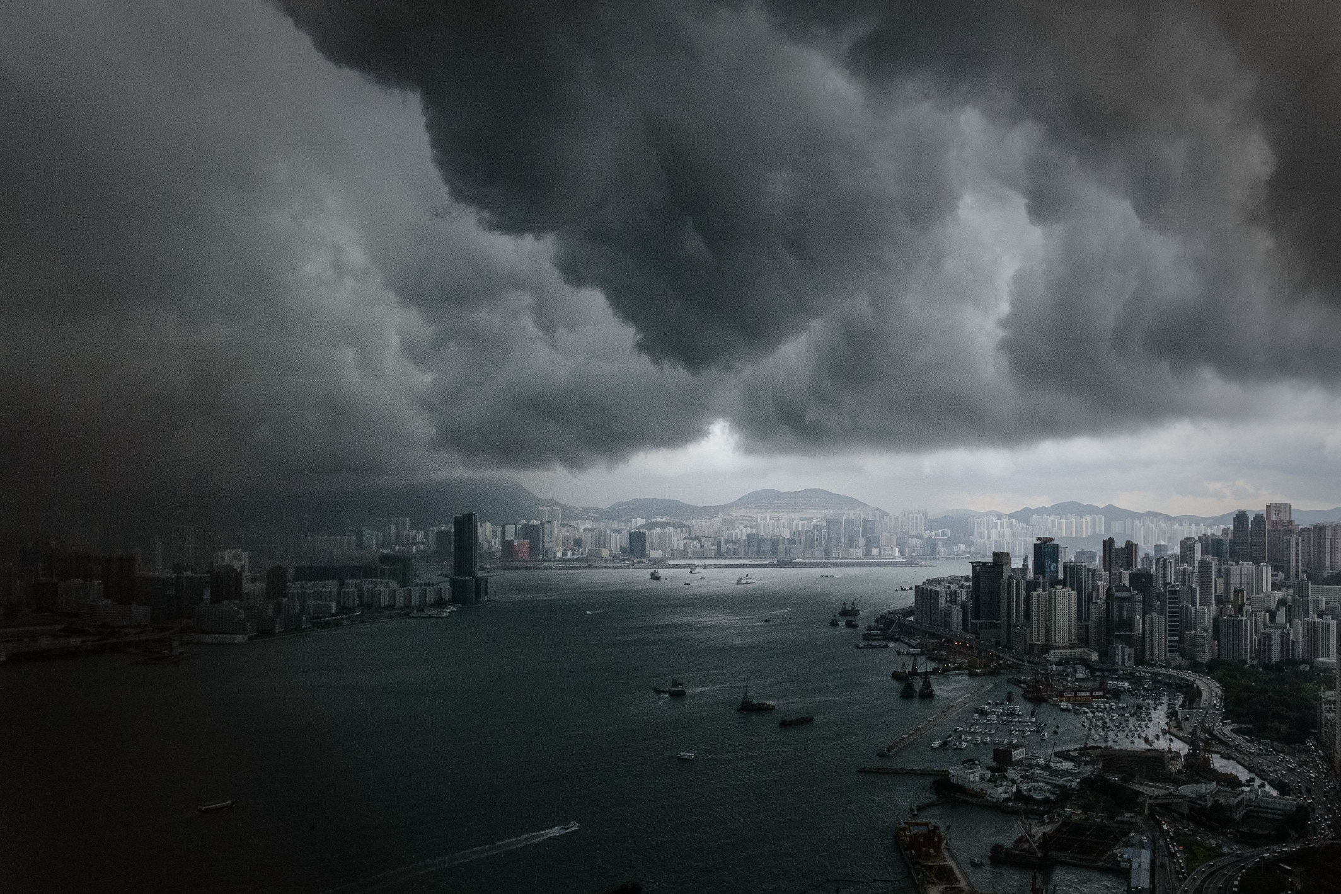
Hurricane

Slide 10
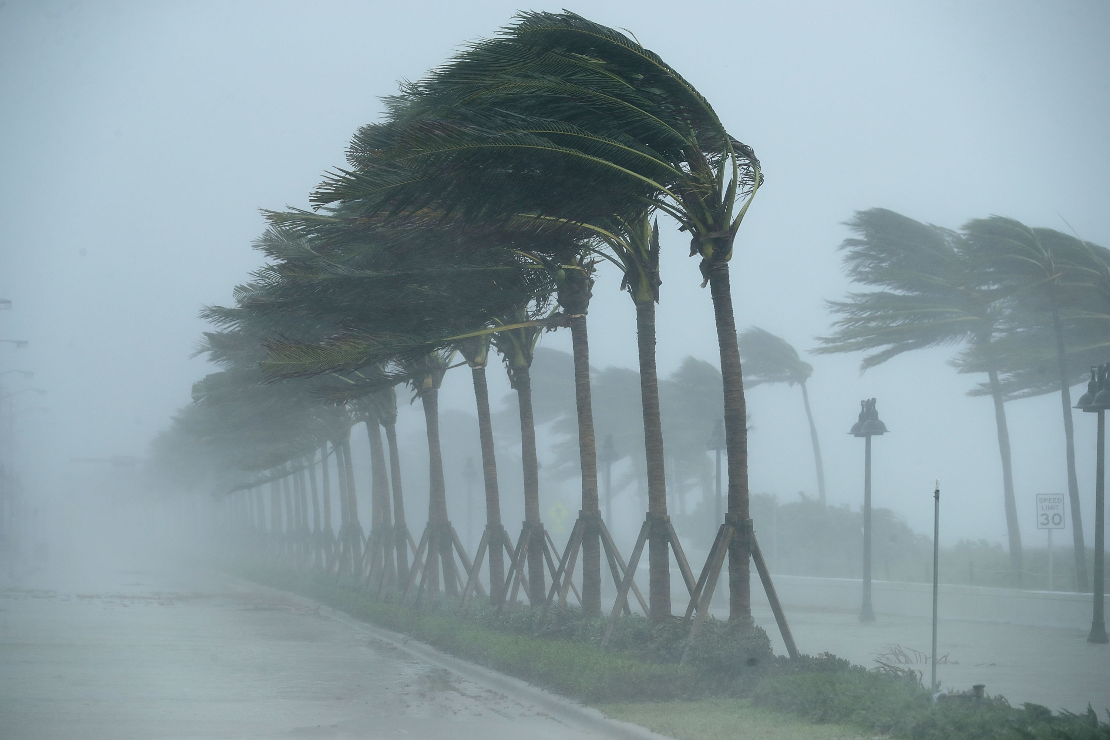
Hurricane

Slide 11
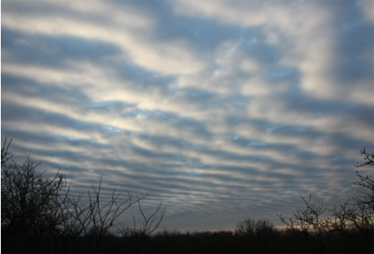
Stratocumulous clouds

Slide 12
Activity: Which clouds are my favorite?

Slide 13
CUMULUS CLOUDS are my favourite type of clouds.
Cumulus clouds have tops that look like cauliflowers, and are flat at the bottom. They form when it’s sunny and don’t make it rain unless they’re very big.

Slide 14
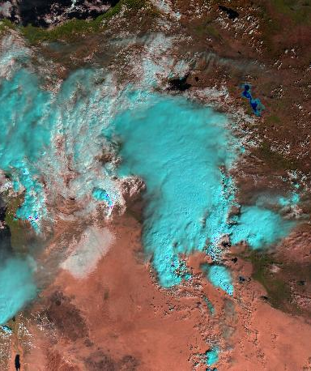
This is what Cumulus clouds look like from space.

Slide 15
CIRRUS CLOUDS are my favourite type of clouds.
Cirrus clouds are high, wispy clouds. They are made of ice crystals and form high up in the atmosphere. Sometimes aeroplanes form thin contrail cirrus, easily spotted on a sunny day.

Slide 16
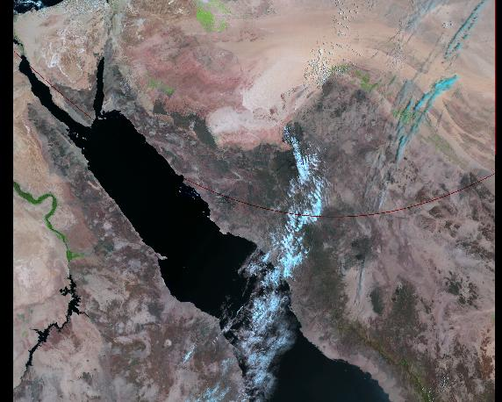
This is what Cirrus clouds look like from space.

Slide 17
HURRICANES are my favourite type of storm.
Hurricanes (also known as a Typhoon or Tropical Cyclone) are huge storm systems. The cloud system they create is easily visible from space. In the Northern Hemisphere, they rotate anti-clockwise. They are often given a name. What will you call yours?

Slide 18
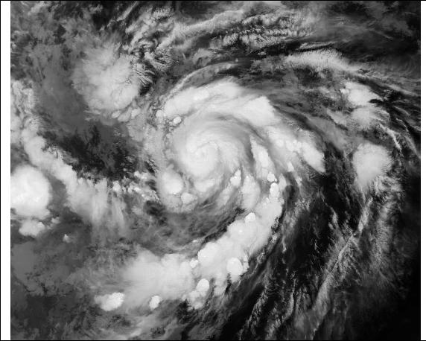
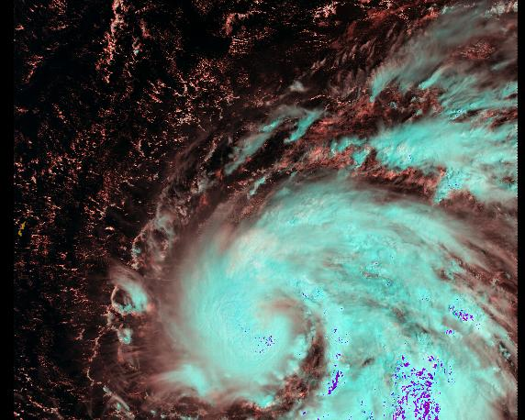
This is what Hurricanes look like from space.

Slide 19
HURRICANES are my favourite type of storm.
Hurricanes (also known as a Typhoon or Tropical Cyclone) are huge storm systems. The cloud system they create is easily visible from space. In the Southern Hemisphere, they rotate clockwise. They are often given a name. What will you call yours?

Slide 20
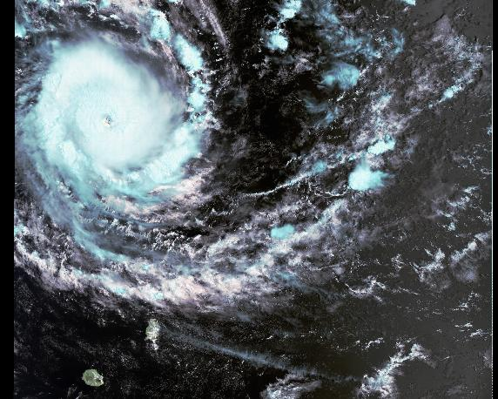
This is what Hurricanes look like from space.

Slide 21
STRATUS CLOUDS are my favourite type of clouds.
Stratus clouds are flat, low cloud. They are a blanket cloud which keeps us warm at night, but blocks out the sun in the day. When stratus is at the ground, we call it mist or fog.

Slide 22
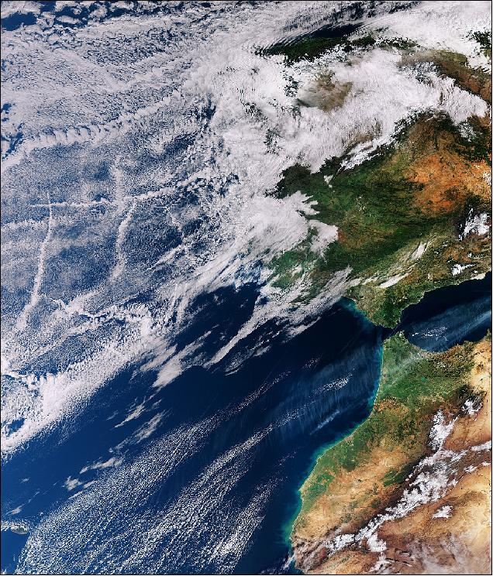
This is what Stratus clouds look like from space.

Slide 23
ALTOCUMULUS CLOUDS are my favourite type of clouds.
Altocumulus clouds are mid-level clouds that appear on fine days. They can appear as heaps or piles of small clouds.

Slide 24
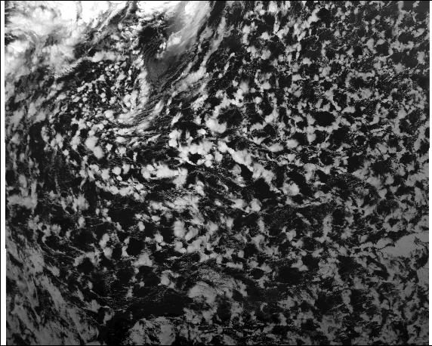
This is what Altocumulus clouds look like from space.

